Slide 1


Slide 2
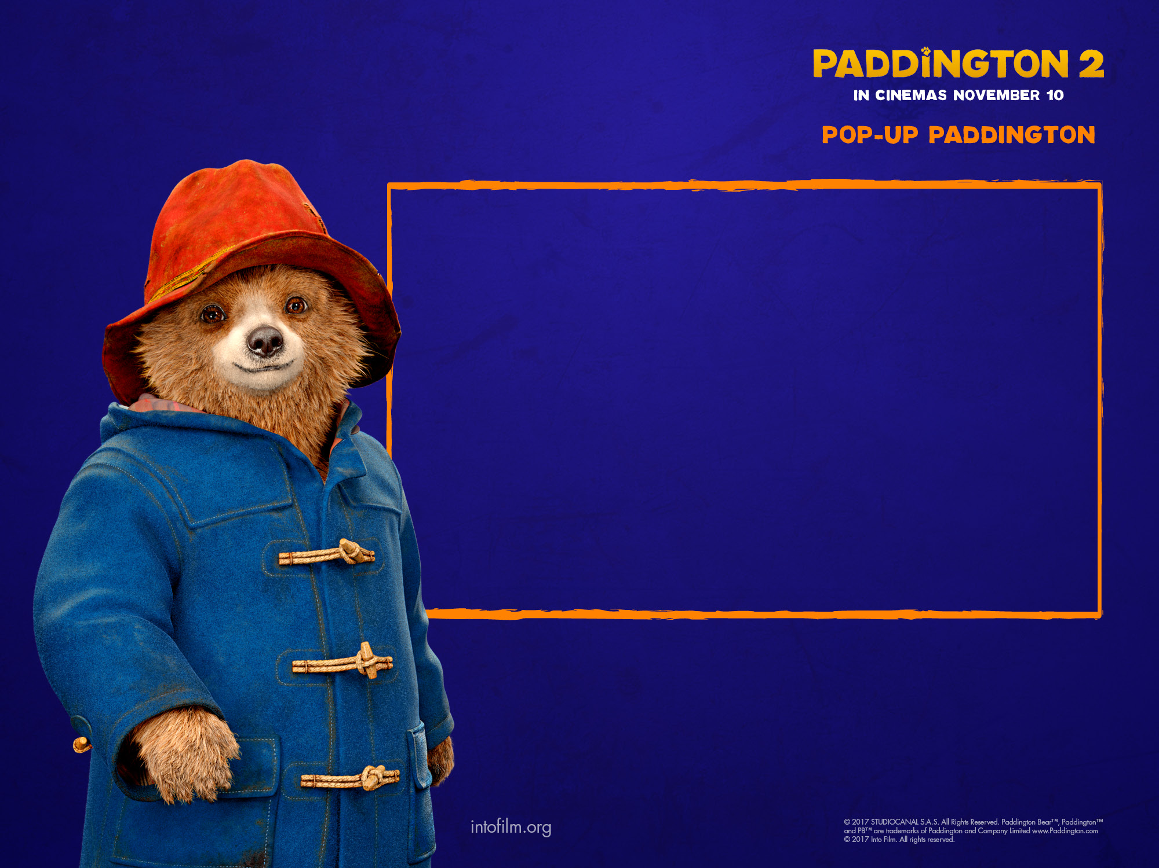
Paddington is coming back to cinemas soon with a new exciting adventure, Paddington 2.
As you watch the trailer, can you think of three adjectives to describe his personality?
Notes:
If pupils are older or working at a higher level, you could ask them to create a 3Cs (colour, character, camera) and 3Ss (story, setting, sound) mind map in response to the trailer. This can then be used as part of the planning process to create their own pop-up story page.

Slide 3


Paddington 2 trailer

Slide 4
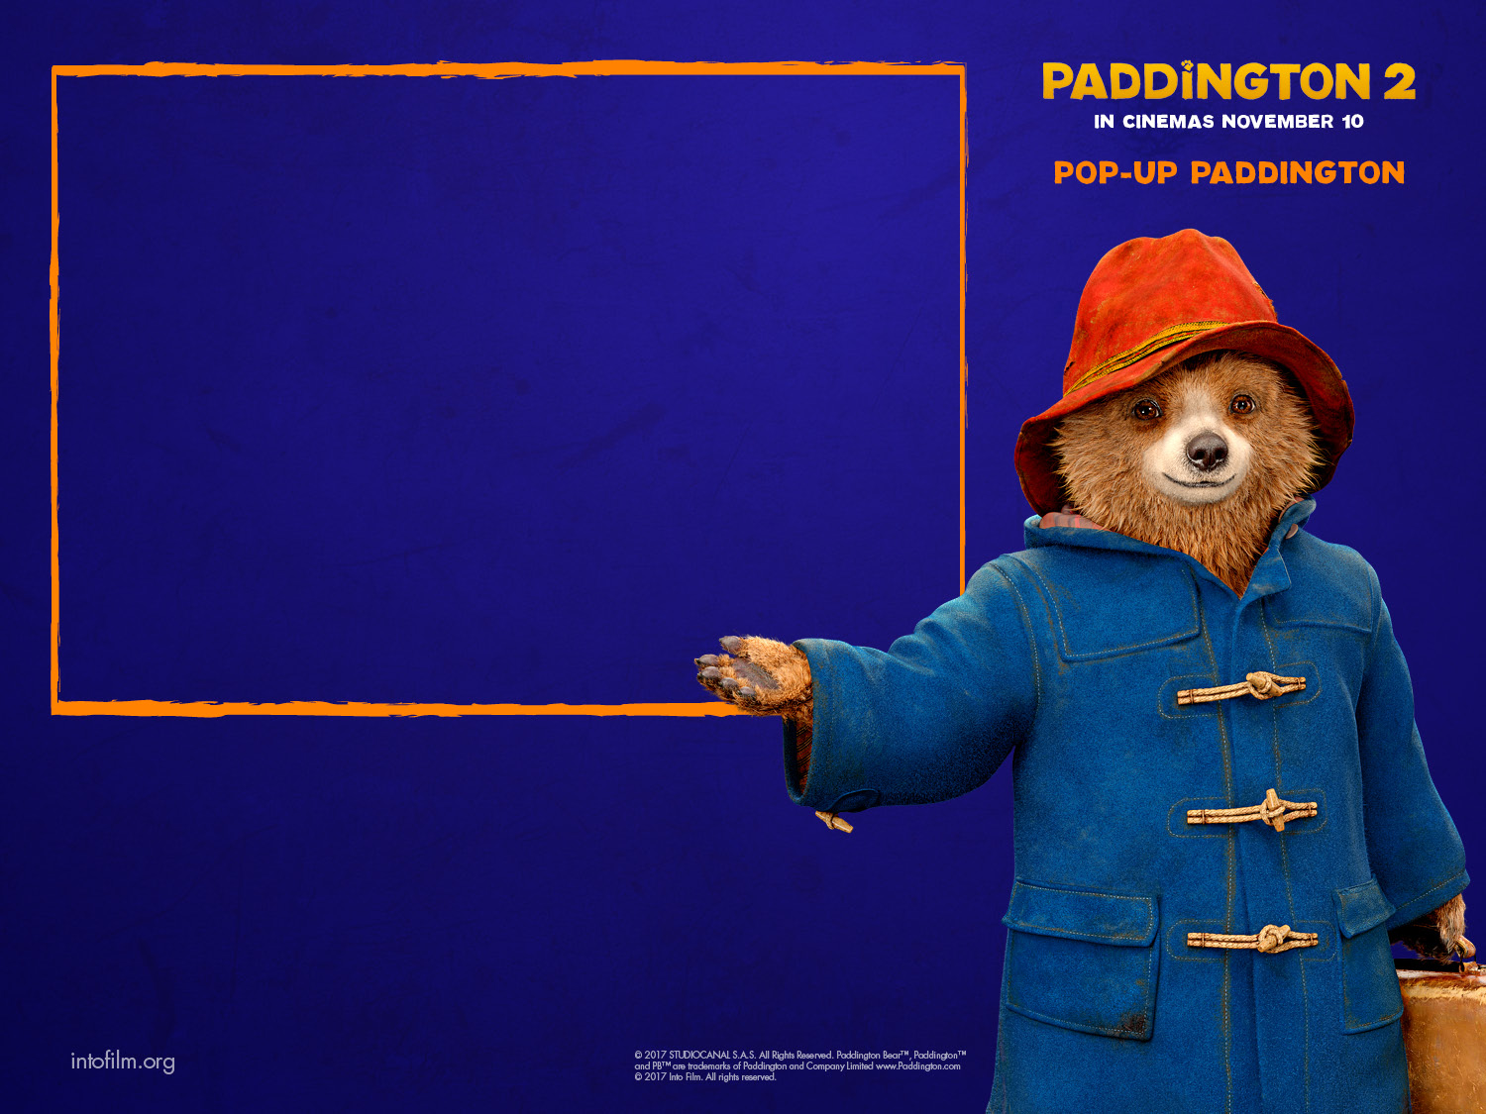
Why do we give presents to the people we care about?
In Paddington 2, Paddington carries out some odd jobs so that he can buy a special pop-up book for his Aunt Lucy’s birthday.
Your task is to create a page for a pop-up book which tells a new story about Paddington and an odd job he might be found doing.
Don’t forget to enter the Pop-up Paddington Competition, for your chance to win official goodies for your whole class, plus a special Paddington 2 prize for the winning entry!

Slide 5


In the film trailer Paddington was helping out by cleaning windows.
In your pop-up book, he will be trying out lots of other odd jobs. Can you think of three he might do?
Housework,
like hoovering
Setting up a computer, tablet or TV
Gardening – raking the leaves or mowing the lawn
DIY – putting up shelves or putting up a picture
Washing
the car

Slide 6

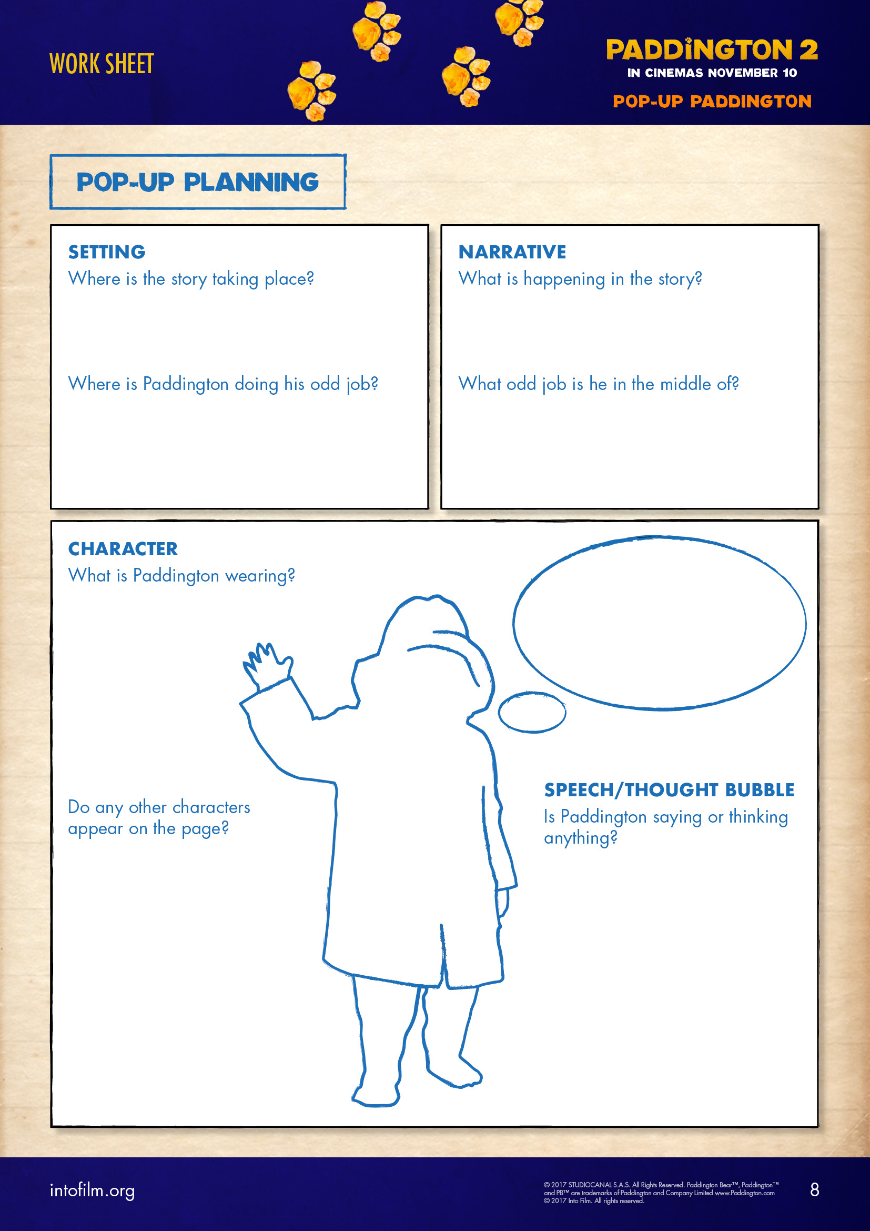
Use your design sheet to plan your pop-up book page.
SETTING – where is the story set? Where is Paddington doing his odd job?
STORY – what is happening in the story? What job is Paddington doing?
CHARACTERS – who else is in the story?
COSTUME – what uniform is Paddington wearing to do his job?
SPEECH – are the characters saying anything? What are they thinking?
Which piece of the page will pop-up?
Notes:
For older or more able pupils, provide some additional storytelling grammar rules they must include. Alternatively, the pop-up book could be aimed at a younger age group in the school, and pupils should choose appropriate language and presentation to suit the target audience.

Slide 7

Pop-up production: OPTION 1
1
2
3
Fold an A4 piece of paper in half and cut along your fold to create two pieces of A5 paper.
Draw a line 3cm along the long edge of one of the pieces of paper. Cut along the long edge to create a long, thin strip of paper.
Make the object or character that will pop-up and stick it on to the end of the long paper strip.
Notes:
For older or more able pupils, support them in creating their own pop-up mechanisms, based on their investigations into pop-up books in the previous lesson.

Slide 8
Pop-up production: OPTION 1
4
5
Cut out a shape for Paddington to hide behind. Something like a door would work well. Stick the top and bottom of it to the other A5 piece of paper (this will be your book page).
Put the character or object into the pocket and label the tab with Push or Pull.
Notes:
For older or more able pupils, support them in creating their own pop-up mechanisms, based on their investigations into pop-up books in the previous lesson.

Slide 9

Pop-up production: OPTION 2
1
2
3
Fold your piece of paper in half.
Draw six lines along the folded edge, so that there are three pairs of two lines. The lines should be 3cm long and 2cm apart. Then cut along the lines.
Unfold the paper and then push through the supporting cut-out tabs, so that they are on the inside.
Notes:
For older or more able pupils, support them in creating their own pop-up mechanisms, based on their investigations into pop-up books in the previous lesson.

Slide 10
Pop-up production: OPTION 2
4
5
6
Fold along the bottom and top of the cut-out tabs where they join the main paper, to create three raised stands.
Unfold the page and colour in your page background, drawing anything that will be flat. Add your lines of narrative or dialogue.
On another piece of paper, draw and cut out any pieces that will stick out slightly on your page. Stick them onto the page with foam pads, if you have any. This might include a gate, tree or tools.
Notes:
For older or more able pupils, support them in creating their own pop-up mechanisms, based on their investigations into pop-up books in the previous lesson.

Slide 11

Pop-up production: OPTION 2
7
On a separate piece of paper, draw and cut out Paddington, wearing the uniform he needs for his odd job, plus any other things you want to pop out of the page.
Glue your pop-up pieces onto the raised tabs in the middle of the page.
Notes:
For older or more able pupils, support them in creating their own pop-up mechanisms, based on their investigations into pop-up books in the previous lesson.

Slide 12
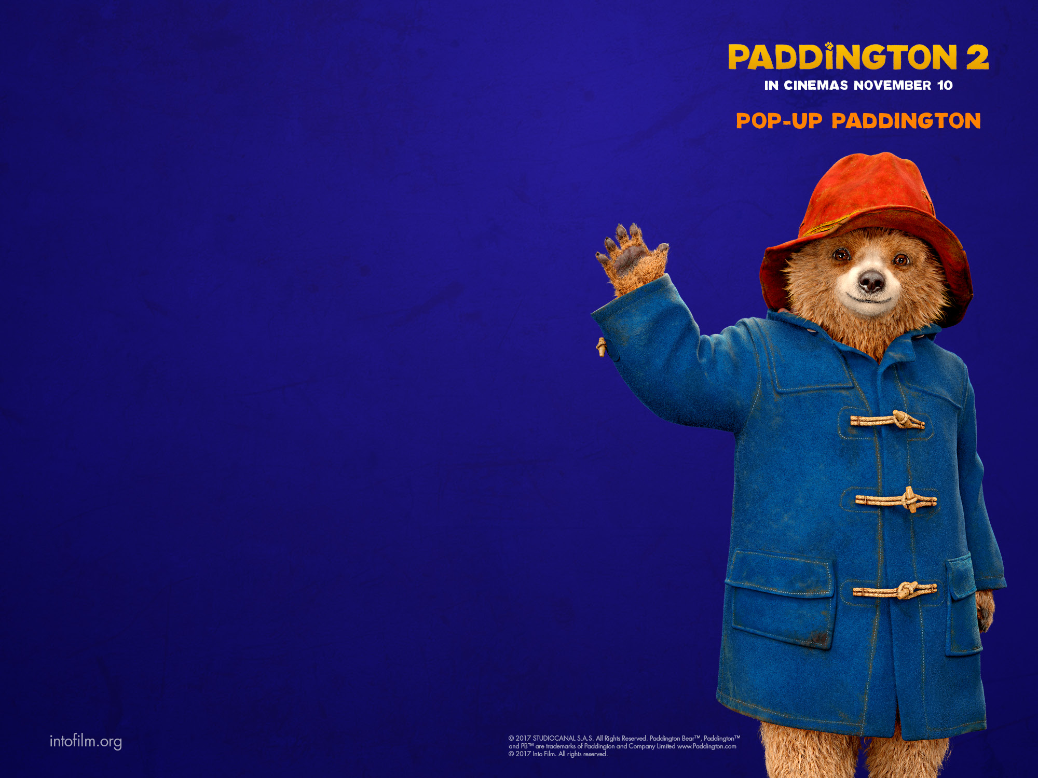
Write or discuss the statements, and choose a traffic light for each one.
I completely agree.
I mostly agree.
I partly agree.

Slide 13

Write or discuss the statements, and choose a traffic light for each one.
If you draw an amber or red traffic light, decide what you will do next time to improve.
I can discuss stories and characters in films and books, explaining my ideas using examples from the text.
I can explain why people do odd jobs and discuss the benefits.
I can investigate and critique pop-up design features.
I can write concise, descriptive sentences to tell a small part in a story.
I can use time connectives to continue a story sequence.

Slide 14
Write or discuss the statements, and choose a traffic light for each one.
I can design and make a pop-up book page with moving and three-dimensional parts.
I can evaluate my pop-up page and consider how I will develop my technique for the future.
My page contains my own line of narrative or dialogue.
My page has an illustration to show where the story is set.
My page has a pop-up feature that works every time.

Slide 15
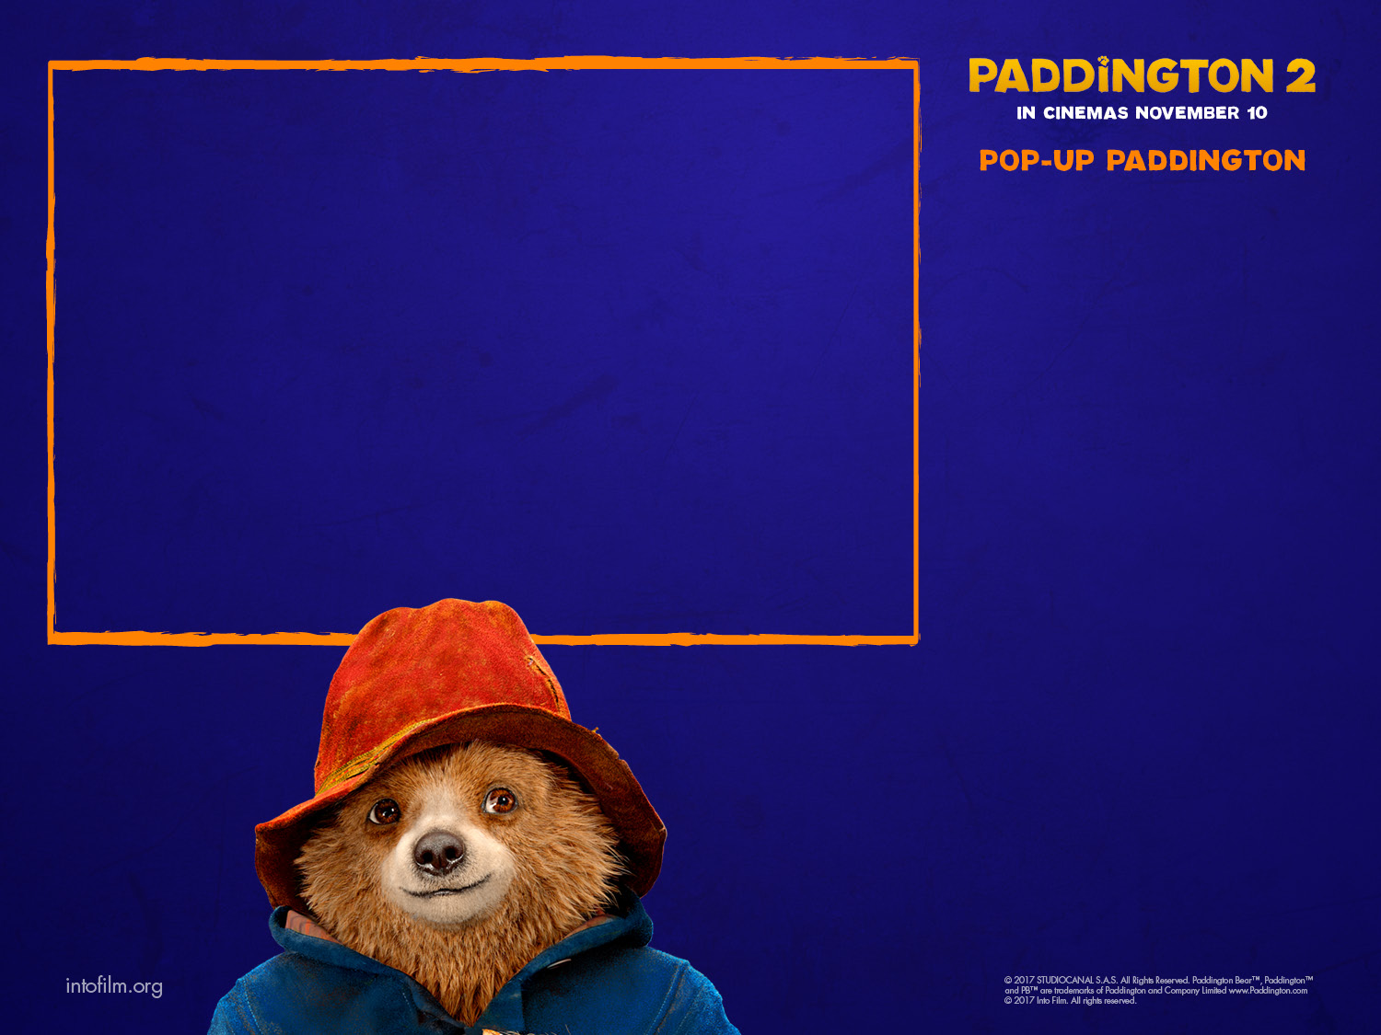

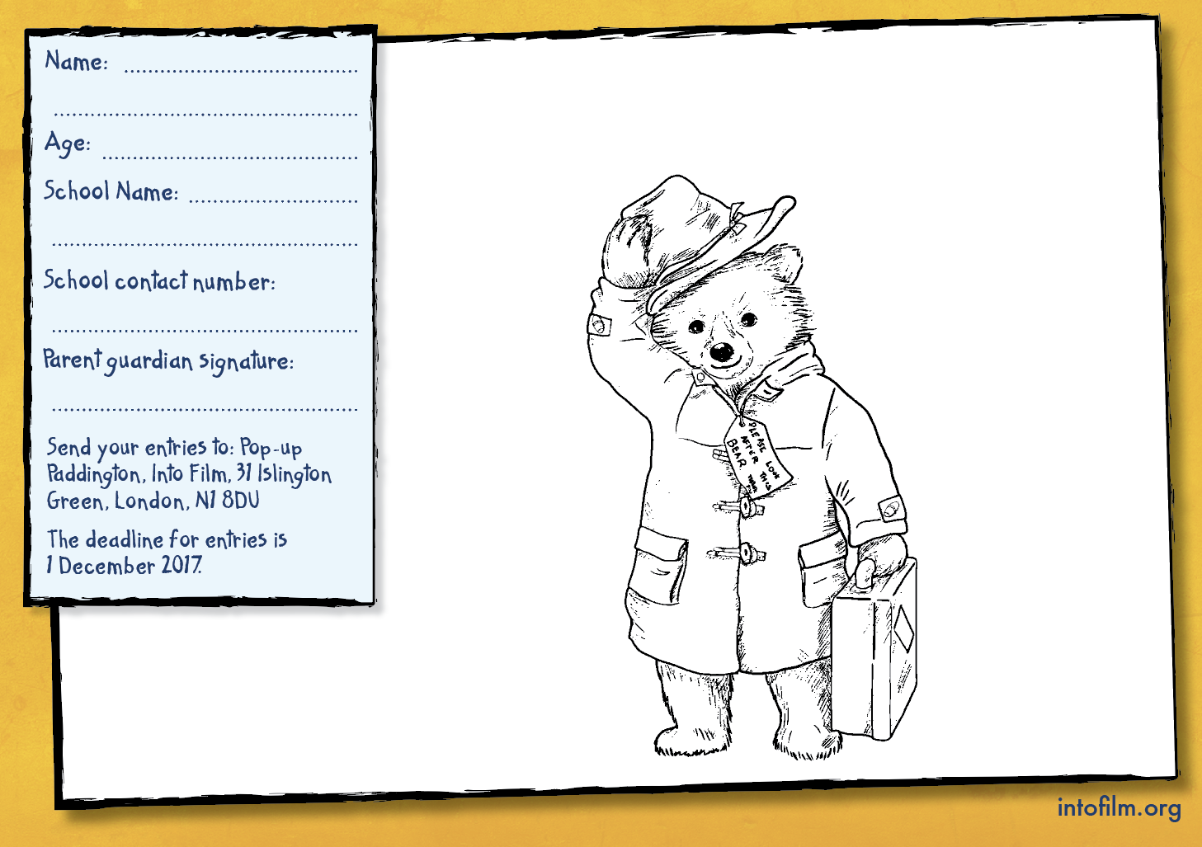
Where will Paddington pop-up next?
Enter the competition for the chance to win official Paddington goodies for your whole class, plus a special Paddington 2 prize for the winning entrant!
All you have to do is draw an interesting place where Paddington can pop-up for an odd job or other adventure. He can pop-up anywhere in the world – near or far!

